Slide 1
​
Face Recognition Unlocking System For Vehicles
Presented by: Batch - 57 Guided by
S Lavan Karthik 2011CS010266 Mrs.S.Sowmya
S Nithin Sai 2011CS010404
P Vennela 2011CS010241
N Sai Kumar Goud 2011CS010185

Slide 2
Introduction
This project aims to revolutionize conventional vehicle access control systems by introducing a cutting-edge Facial Recognition Unlocking System based on advanced machine learning algorithms. The primary objective is to enhance the security and user experience associated with vehicle access, catering to the evolving demands of the automotive industry.
To enhance security, the system employs multi-factor authentication, combining facial recognition with additional user-specific parameters . This model approach adds an extra layer of protection against unauthorized access.The effectiveness of the Face Detection Unlocking System is evaluated through extensive testing scenarios, demonstrating high accuracy and reliability.

Slide 3
Objective of the Project
Security Concerns with Traditional Locking Systems: Traditional car locking systems, such as physical keys or remote key fobs, are susceptible to theft, loss, or unauthorized duplication, compromising the security of vehicles.
Inconvenience and Accessibility Issues: Users often face inconvenience and accessibility issues associated with traditional locking systems, such as the need to carry and locate physical keys or key fobs.
Facial Recognition in Automotive Security: There is a need to explore the integration of facial recognition technology into automotive security systems to provide a secure and convenient method of vehicle access.

Slide 4
Existing System
The existing car unlocking system relies primarily on conventional methods such as physical keys or remote key fobs for access control. These methods, while widely used, are prone to security vulnerabilities, including theft, loss, or unauthorized duplication of keys. Moreover, manual authentication processes can be time-consuming and inconvenient for users, leading to potential inefficiencies and security risks.
Disadvantages:
Low Efficiency :The keyless systems do have cons. Anyone who has driven a vehicle for some time knows that components eventually break or wear out over time. When this happens, you’ll have to use the manual key to start the vehicle until you get the system repaired.
Instances of low accuracy, attributed to factors such as environmental variationscan compromise the effectiveness of these systems.

Slide 5
Proposed System
The proposed unlocking system introduces a approach based on facial recognition technology and the Haar cascade algorithm. This system aims to enhance security and convenience by replacing traditional authentication methods with biometric-based identification. By leveraging facial recognition, the proposed system offers a more secure and efficient means of granting access to authorized users.
The Haar cascade algorithm, known for its robustness and accuracy in facial recognition tasks, forms the core of the proposed system's authentication mechanism. This algorithm generates secure hashes from facial features, ensuring reliable identification of authorized individuals while protecting against unauthorized access attempts.

Slide 6
In addition, the system incorporates a user-friendly graphical interface developed using Tkinter, a Python library for creating GUI applications. This interface provides users with intuitive controls for initiating the authentication process and accessing the vehicle. Through the combination of facial recognition technology, the Haar cascadealgorithm, and a Tkinter-based GUI, the proposed system offers a comprehensive solution for secure and convenient car unlocking.

Slide 7
SYSTEM ANALYSIS
Hardware requirements
Processer : Any Update Processer
Ram : Min 1 GB
Hard Disk : Min 100 GB
Software requirements
Operating System : Windows
Technology : Python 3.6
IDE : Anaconda
Library : Opencv

Slide 8
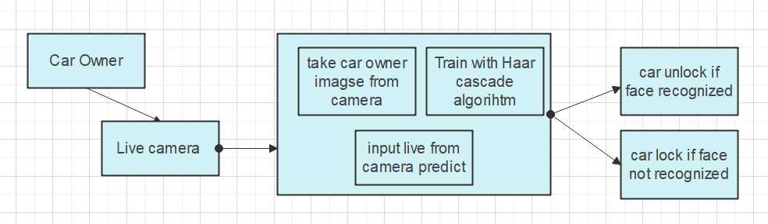
Methodology

Slide 9
Scope of the Project
In the future, modern vehicles are equipped with cameras, microphones and sensors installed to perform different functionalities such as tracking and recognizing users and interpreting their behaves by extracting and processing the required data. Face recognition is best way to finding its way into new generations of vehicles in increasing safety and convenience. Face recognition works on a simple principle.
After author enrolls into the system, the system remembers them. The facial recognition concept is applied to real-time car theft detection applications. A web camera is placed at the car door where the video frames are re-encoded and the face of the person trying to unlock the car is recognized using facial recognition algorithms will be if the person is not the user, the car door will not open.

Slide 10
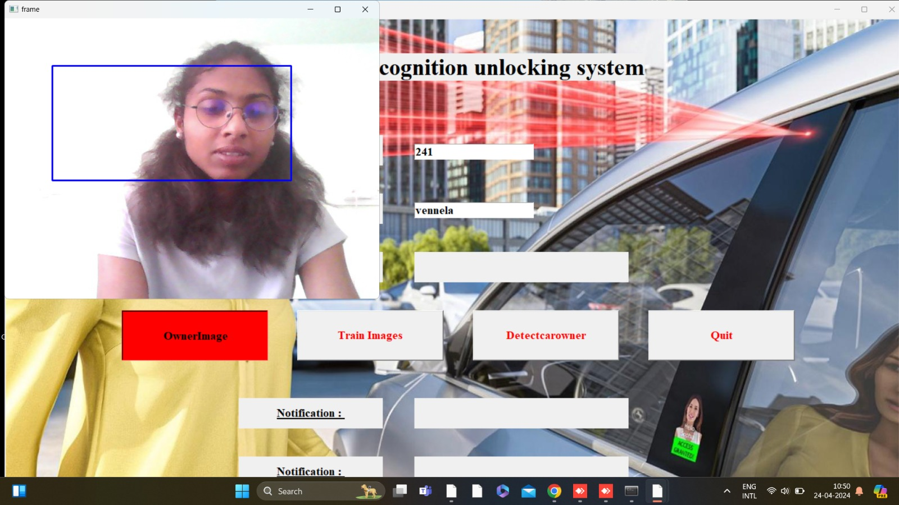
Result
Taking of the owner image for registration

Slide 11
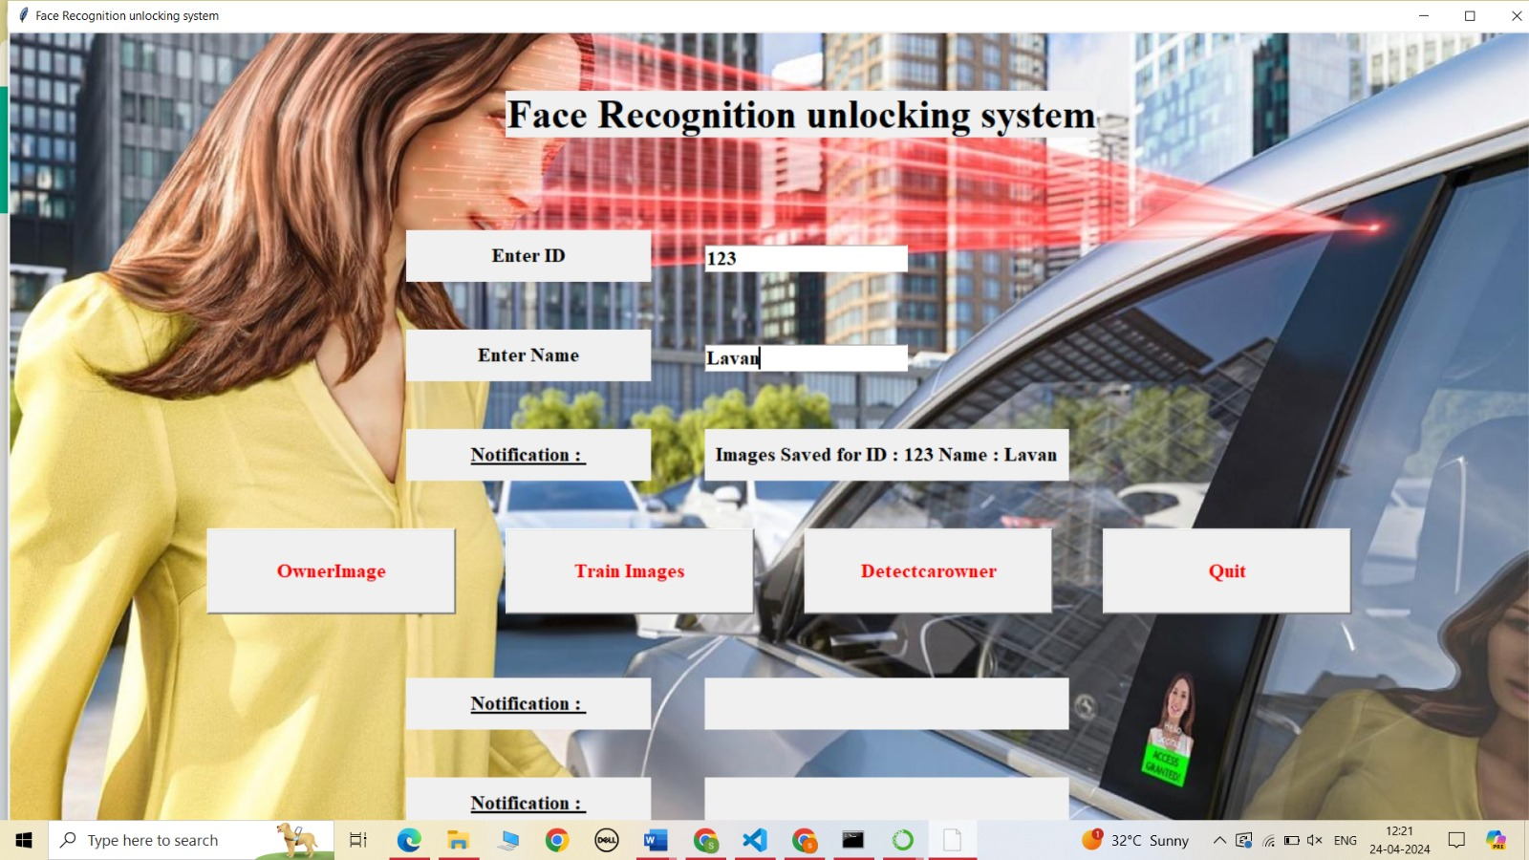
Images saved with the name and mobile number

Slide 12
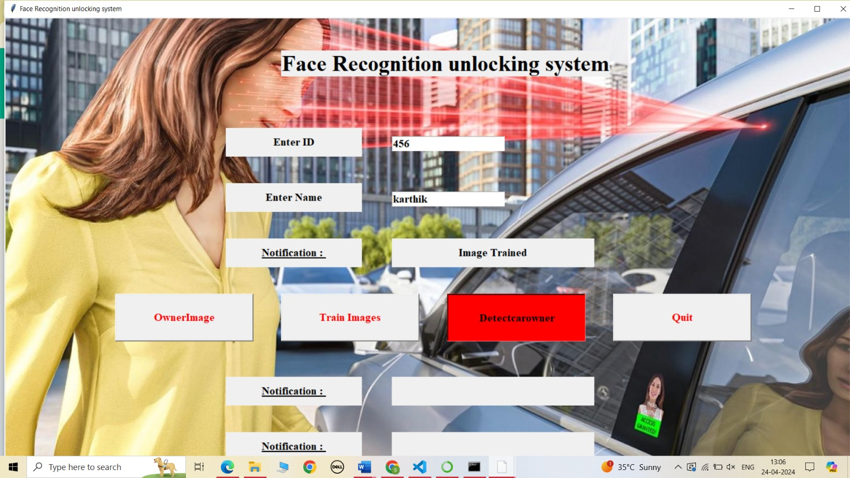
Training images that stored in the folder

Slide 13
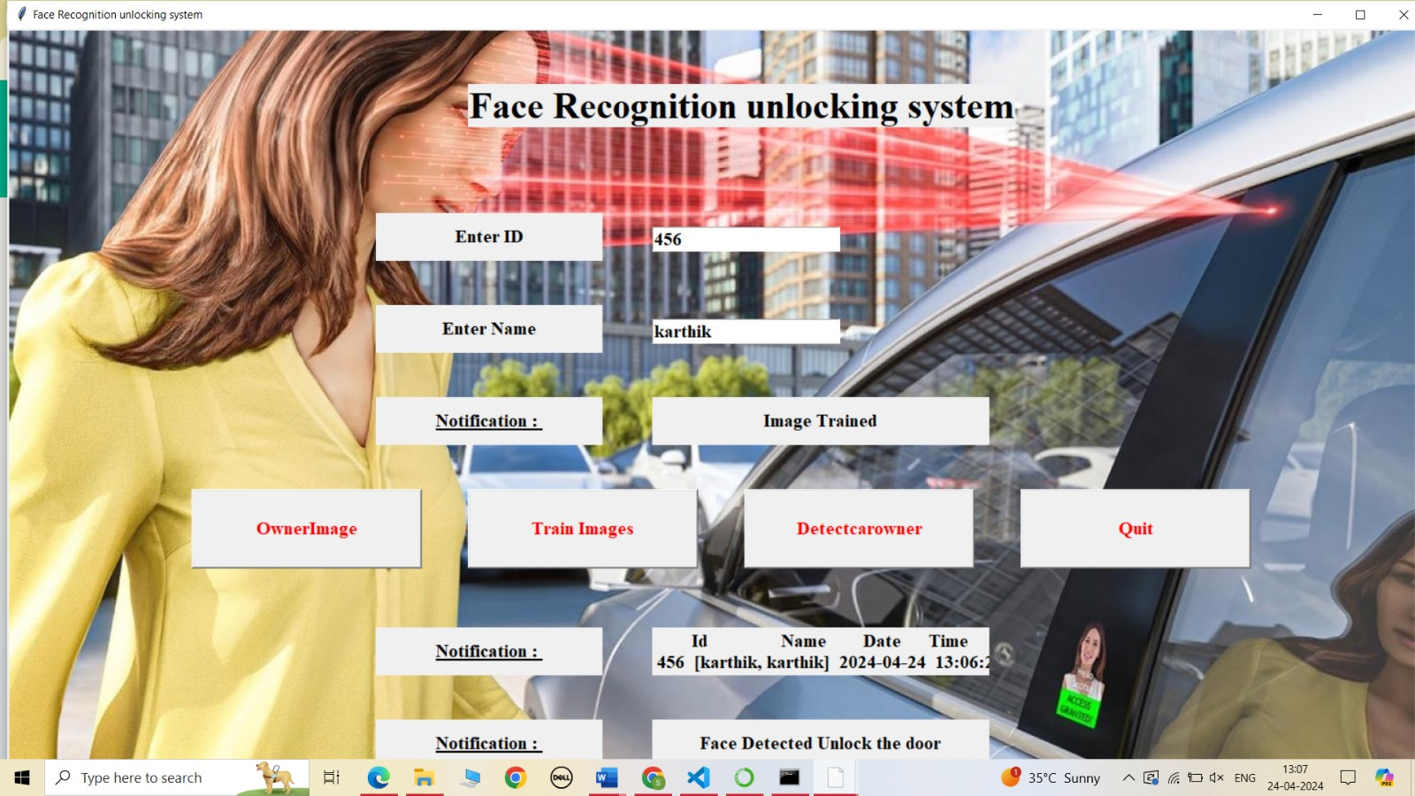
Detecting the image of the user and given details

Slide 14
THANK YOU

